Slide 1
Test2Achieve: AI Based Evaluation System
Bharat Sharma
Shanmukha Sai Penumatsa
Adithya Vinod
Deep Learning (Spring, 2023)
Youakim Badr

Slide 2
2 min to convince the audience
The existing grading system has great reliance on manual processes and often involves significant amount of human bias and inconsistent scoring
To address these issues, we envision on building an AI based system that builds answers to questions and grades student performance based on their submissions and provide accurate, consistent and fair evaluation of student performance
In the world where CHATGPT exist, we want to give some powers to faculty by automating the process of evaluation and answer generation.

Slide 3
Context and Introduction
The conventional education grading system suffers from several challenges such as over-reliance on manual processes that consume faculty time and resources, leaving little time for research or student engagement. Besides, there is considerable human bias and inconsistent scoring, adding to the system's inefficiency.
We plan to build a solution that seeks to automate the grading process, cater to various types of assignments, ensure precise, reliable, and impartial evaluation of student performance, and process massive amounts of data.

Slide 4
Problem and Challenges
Despite the abundance of research on the topic, there aren’t real applications in usage that help in answer generation as well as for grading the answer provided. This leaves room for the question regarding if this is something that is achievable.
One of the major obstacles in developing deep learning solutions is the scarcity of data, the dataset that we will be working on has not been updated for the past 10 years and is the only public data source that is publicly accessible, with many studies conducted on private data, making it challenging to reproduce and improve the results.

Slide 5
Related solutions / State of Art
Significant research has been conducted on using Deep Learning and NLP to understand and evaluate descriptive text based on different similarity criteria. A few research papers that we referred include:
"A Deep Learning Approach for Similarity-Based Text Evaluation" (2017)
"Evaluating Text Similarity using Deep Learning Models" (2018)
"Deep Text Similarity Learning for Evaluating Descriptive Text" (2020)
"Generating Descriptive Answers Using NLP and Knowledge Bases" (2017)
"An NLP-Based Approach for Generating Descriptive Answers to Questions" (2018)

Slide 6
Overview of Solution / Contributions
We have tried to solve this problem by breaking it down into two independent problem statements, namely:
Automated Answer Generation:
We will be using pretrained models like Bert, Roberta, Albert and Electra for answer generation tasks, where given a question or prompt, the model generates an answer. These models are trained on large amounts of text data and can learn to generate coherent and accurate responses.
Automated Grading:
The answer and scores are first passed through the LSTM which are then passed through the multiple neural layers to train the model. The trained model will return a score for each answer based on historic grading.

Slide 7
Data Collecting for Answer Generation
We have used SQUAD 2.0 dataset for building the neural network for answer generation
Stanford Question Answering Dataset (SQuAD) is a reading comprehension dataset, consisting of questions posed by crowd workers on a set of Wikipedia articles, where the answer to every question is a segment of text, or span, from the corresponding reading passage, or the question might be unanswerable
We have used python function !wget to save the JSON data from the link https://rajpurkar.github.io/SQuAD-explorer/dataset/train-v2.0.json

Slide 8
Data Preprocessing for Answer Generation
Finding the end position character is a very important input for all the answer generation models as it needs both start and end position characters of the answer. This needs to be found and stored.
There are cases where the SQuAD answers are missing one or two characters from the real answer in the passage and can be challenging, as it can affect the performance of these answer generation models that rely on precise tokenization. One approach to address this issue is to modify the passage to match the given answer by "cutting" it by one or two characters by using a compatible tokenizer.

Slide 9
Methodology
The whole process is divided into 4 phases–
Data preparation: Downloaded the SQuAD (Stanford Question Answering Dataset) dataset. Preprocessed the dataset by tokenizing the text using tokenizers for each model and applying it onto train and validation sets. Also identified the starting and ending position of each answer since these are used as inputs for chosen pretrained models
Model selection: Decided which models to use for the task, in this case BERT, ROBERTA, ELECTRA and ALBERT. These models have been shown to perform well on natural language processing tasks and are widely used in research and industry.

Slide 10
Methodology
Model fine-tuning: This involves training the models on the train set, using the questions as inputs and the answers as outputs, and adjusting the model's parameters to minimize the loss. The loss function measures the difference between the predicted and actual answers.
Model evaluation: Evaluated the performance of the models on the validation set by measuring their loss and F1 score. The F1 score is the harmonic mean of precision and recall and is commonly used to evaluate question-answering models.

Slide 11
Model selection and parameters
All the above-mentioned Answer Generation models are a pre-trained transformer-based deep learning model that can be fine-tuned for various natural language processing (NLP) tasks, including question answering.
Normalization: These models center the data around zero and scale it to have unit variance.
Regularization: These models uses dropout regularization during training, which randomly drops out some neurons in the network to prevent them from being too reliant on each other.
Layers: All these models are deep neural network with multiple layers. These layers are used to extract high-level features from the input data.
Activation functions: Common activation functions used in our models ReLU (rectified linear unit) and GELU (Gaussian error linear unit). These activation functions help the model learn complex patterns in the data.

Slide 12
Network Training – validation - testing
We have trained and tuned the pre-trained models by using 40,000 datapoints of paragraphs, question and answers. And similarly, we have used about 20,000 datapoints for testing set.
We have chosen a learning rate = 5e-5 (since higher learning rate was resulting in poor model).
For optimizer we have used Adam optimization algorithm which uses weight decay as loss function.
We have used epochs ranging from 2-3. And the reason for lower epochs is that we are using transformers models which requires high computation power and takes higher execution time.

Slide 13
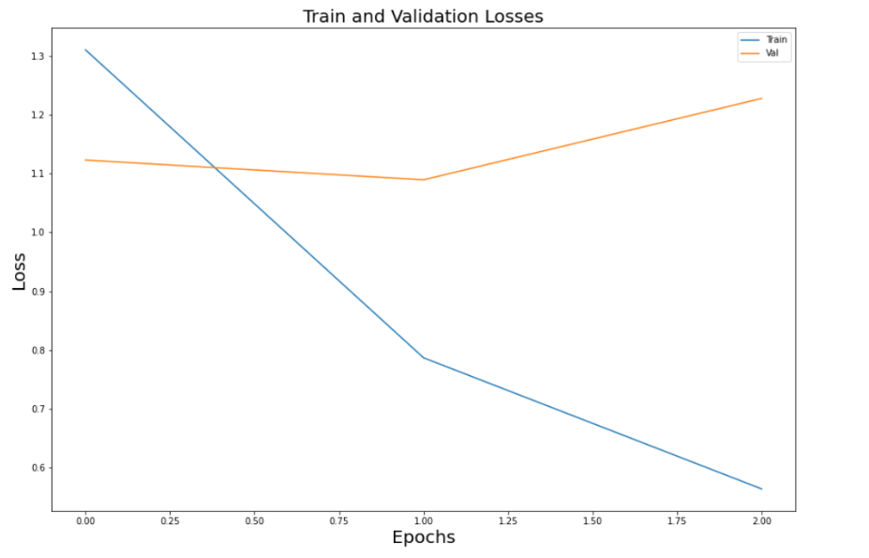
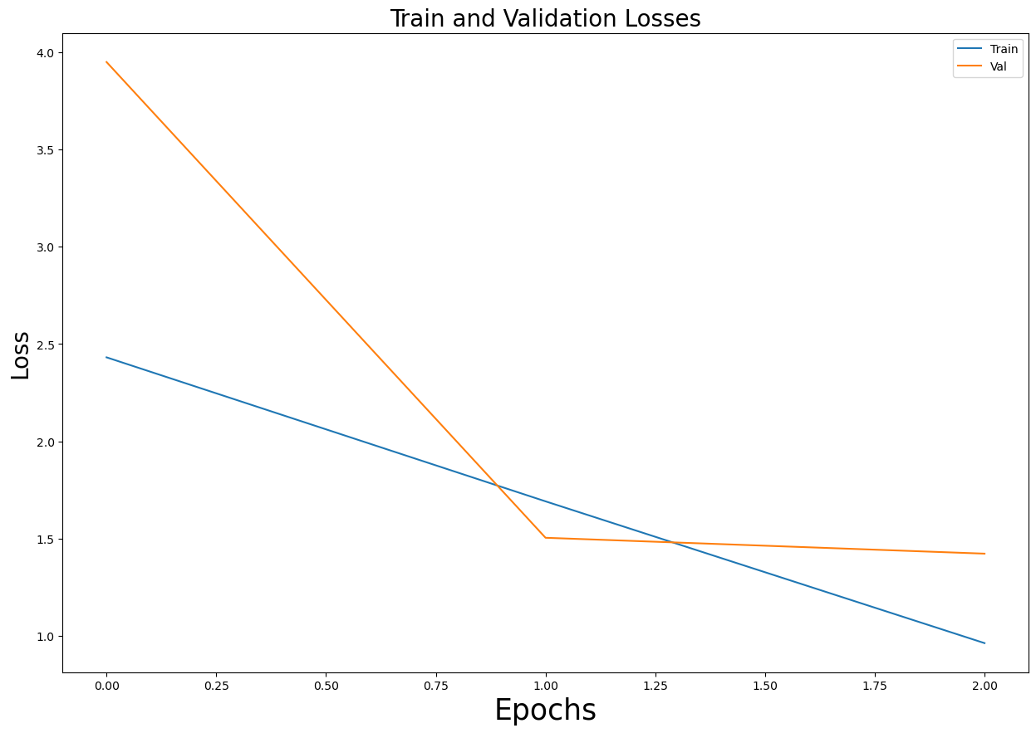
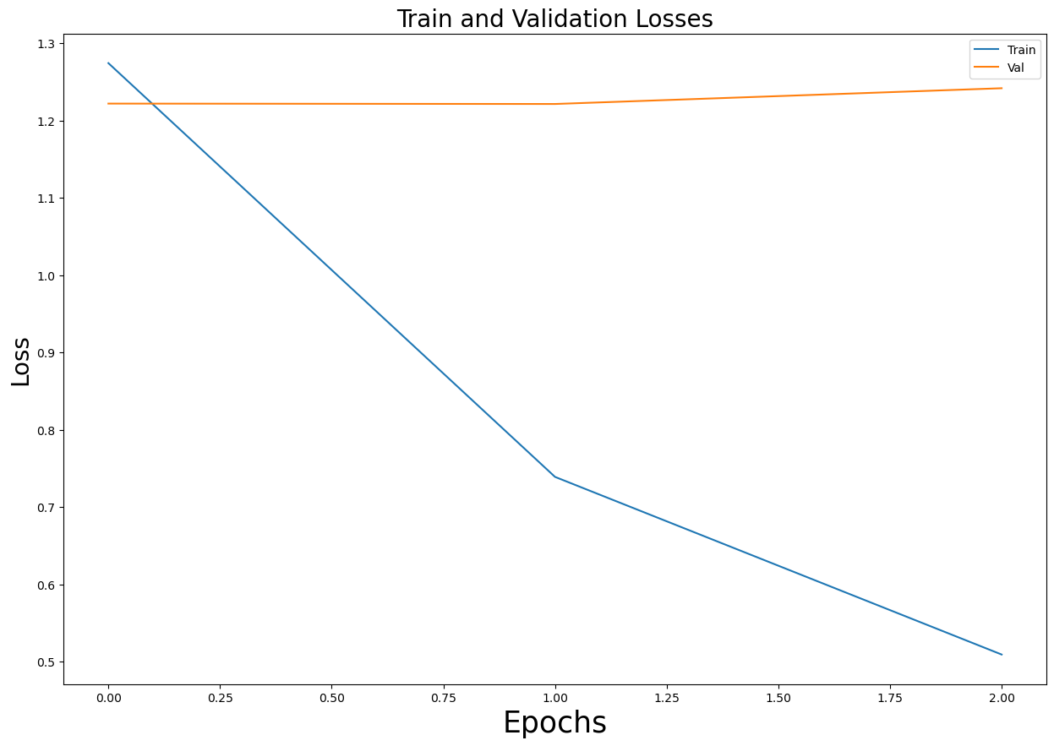
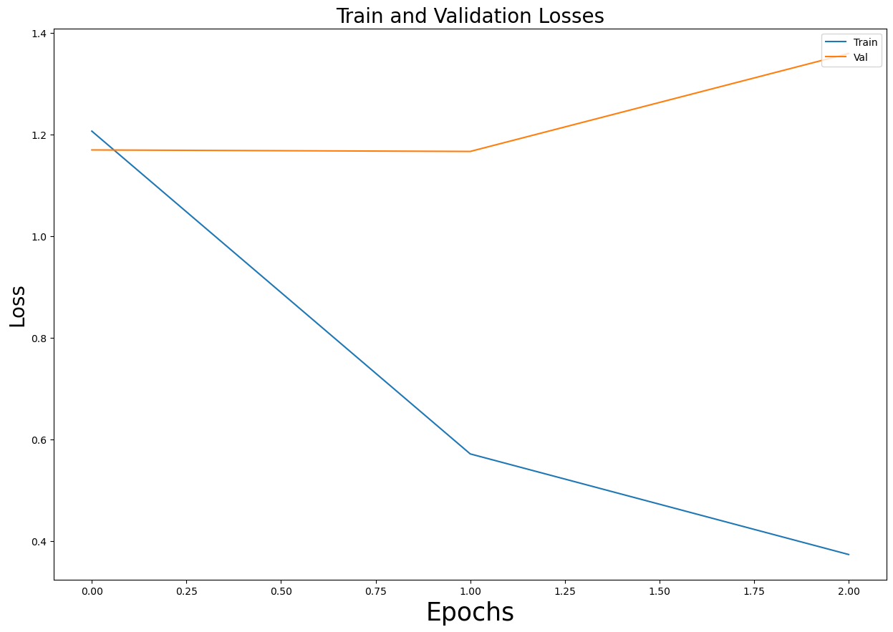
Evaluations – Performance – comparing
Inferences:
ROBERTA performs the best when compared to the rest as we can the validation loss decrease along with the training loss.
Increasing the Learning rate reduces the performance of the model.
Data needs to be trained for larger number of epochs as we see a scope of improvement in performance of these models.
BERT
ROBERTA
ELECTRA
ALBERT

Slide 14
Evaluations metrics
The evaluation metrics that we have used are:
Exact Match: measures whether the predicted answer exactly matches the ground-truth answers. If the exact matching occurs, then assigns 1.0, otherwise assigns 0.0.
F1 Score: computes the average word overlap between predicted and ground-truth answers, which can ensure both of precision and recall rate are optimized at the same time.
 | BERT | ROBERTA | ALBERTA | ELECTRA
F1 Score | 0.387 | 0.83 | 0.34 | 0.44
We can see that ROBERTA outperforms the other models. This can be attributed to the fact that ROBERTA is trained on a larger corpus of text and has a slightly larger architecture with additional layers and larger hidden sizes.

Slide 15
Outcomes/finding
From the previous slides, we can see a decreasing trend in terms of training loss but the same can't be said regarding the validation loss.
This could be because the model was trained on just 3 epochs because of computational constraints, and we could understand the model better if we were to run it for a larger number of epochs.
This could also be because of the quality of data and a better data source could help improve the performance.

Slide 16
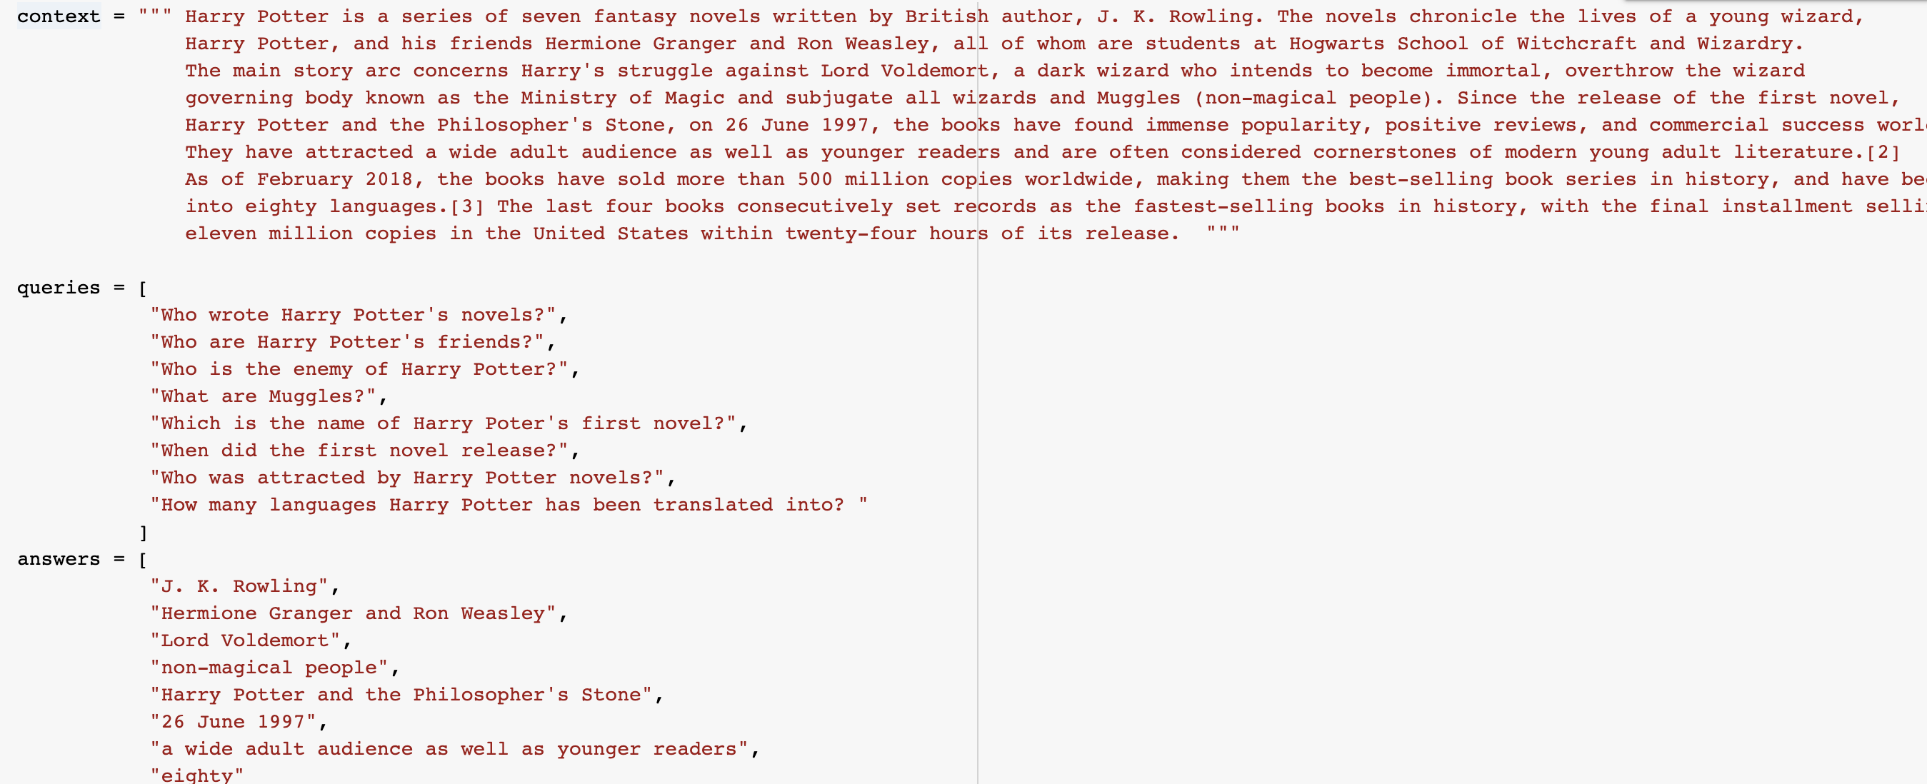
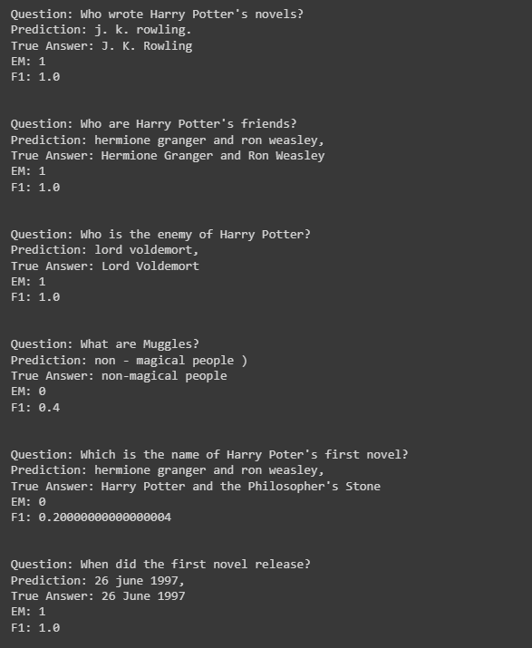
Demo Question-Answering

Slide 17
Data Collecting
We have used “The Hewlett Foundation: Automated Essay Scoring” dataset for building the neural network for answer grading.
It contains information about:
The essay: It contains the answer written by the student on a given topic
Essay id: The answer individual with essay id
Grades: It contains the grades given by different instructors
Each essay is approximately 150 to 550 words in length.
Lowest amount of training data is 1,190 essays, randomly selected from a total of 1,982.

Slide 18
Data Preprocessing for Answer Grading
Dropping Null Values: Removing the missing values from the dataset.
Text cleaning: Removing irrelevant information like punctuation, numbers, special characters, and stop words from the text.
Tokenization: Breaking down the text into smaller parts, called tokens, which can be analyzed individually.
Stop word removal: Removing common words like "the", "and" and "a" that are not important for analysis.
Stemming and Lemmatization: Reducing words to their root form to group together different inflected forms of a word, such as "run," "running," and "ran."

Slide 19
Methodology
The whole process is divided into different phases –
Preprocessing and cleaning: After we downloaded the dataset we tokenized the dataset into 2 parts:
Sentence based tokenizer: To remove punctuations and preserving the context
Wordlist based tokenizer: To clean the data (removing stop words, converting to lowercase)
Vectorize: After initial pre-processing we created 3 separate functions
Function makeFeatureVec creates an average feature vector for a given list of words, using a trained word2vec model and the number of features as input. It returns a feature vector as a NumPy array.
Function getAvgFeatureVecs generates word vectors for a list of essays. It takes a list of essays, a trained word2vec model, and the number of features to use as input. It calls the makeFeatureVec function on each essay and returns a matrix of feature vectors.

Slide 20
Methodology
3. Function makeFeatureVec (updated) creates an average feature vector for a given string of words, using a trained word2vec model and the number of features as input. It returns a feature vector as a NumPy array.
Model Selection: SpaCy is a popular natural language processing library that provides pre-trained models for tasks such as part-of-speech tagging, named entity recognition, and dependency parsing. For our base model we have used.LSTM can capture the long-term dependencies and relationships between words in an essay, making it a suitable choice for grading written answers. It can also handle variable-length sequences, which is important for essays of different lengths.
Model Specification: The model consists of two LSTM layers followed by a Dropout layer and a Dense layer with a single output node. The model is compiled using the mean squared error loss function, RMSprop optimizer, and three metrics: mean absolute error (MAE), accuracy, and the default binary accuracy. For SpaCy model we are using the similarity score as a metrics with the original score to check for accuracy of the mode.

Slide 21
Model selection and parameters
When training a LSTM for automated grading, there are several factors to consider, including model selection and parameter tuning.
Determine the input and output: Decide on what the input to the model will be (student essays) and what the output will be (score).
Choose a LSTM architecture: Choose an architecture that is suitable for the task of automated grading. LSTM is a good choice for this task as it is capable of processing sequential data and can handle long-term dependencies.
Train the model: Train the LSTM on the training data and evaluate its performance on the validation set. If the model is overfitting, adjust the hyperparameters or use techniques such as regularization to reduce overfitting.
Evaluate the model: Evaluate the performance of the model on the test set. If the model performs well, it can be deployed for automated grading.

Slide 22
Network Training – validation - testing
We have trained and tuned the LSTM models by using about 13,000 datapoints of essays and their respective grades. And similarly, we have used 4300 datapoints for testing set.
We have chosen a learning rate of 1e-5.
For optimizer we have used RMSprop optimization algorithm which adjusts the learning rate of each weight based on the history of the gradients of that weight.
We have used 5-fold cross validation with 100 epochs to find the best model, which is then saved.

Slide 23
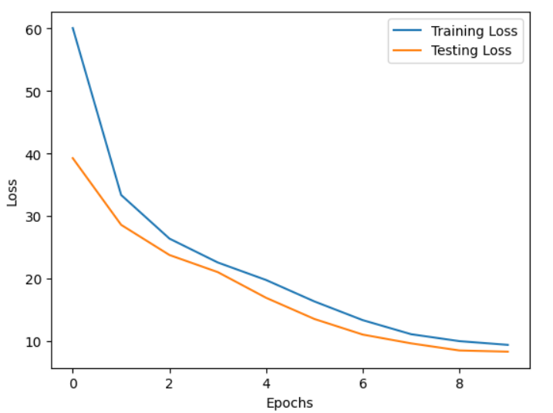
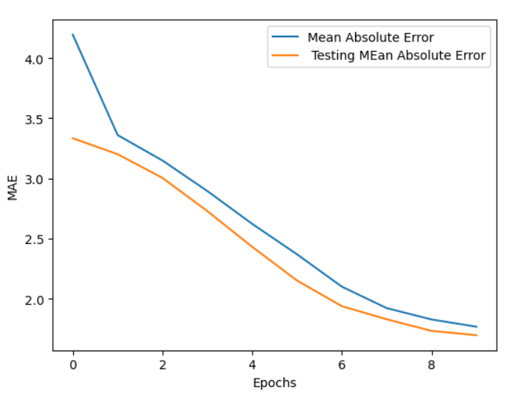
Evaluations – Performance – comparing
Inferences:
From the loss graphs, we can infer that there are no overfit issues since the loss for both test and train drops
The drop in MAE with increase in epochs indicate the improvement of the model performance
The model performance almost reaches saturation near 10 epochs so there is only slight scope of improvement

Slide 24
Lessons learned and Perspectives
Building answer generation models using pre-trained models can be a challenging and rewarding process.
We have learnt that preprocessing the data is a key component while building a deep learning model as it can significantly impact the performance of the model.
We also learnt the hard way that running Transformers Deep Learning models can be time consuming and resource heavy.

Slide 25
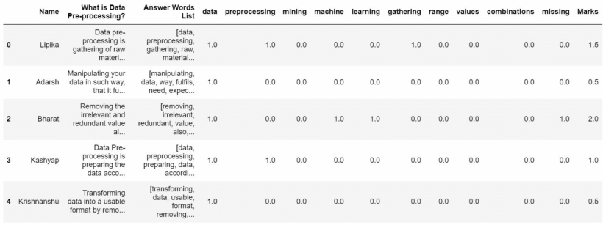
Demo Automatic Grading

Slide 26
Bibliographical References
Dataset 1 - https://rajpurkar.github.io/SQuAD-explorer/
Dataset 2 - https://www.kaggle.com/competitions/asap-sas/data
https://huggingface.co/docs/transformers/tasks/question_answering
https://github.com/alexaapo/BERT-based-pretrained-model-using-SQuAD-2.0-dataset
r-net.pdf (microsoft.com)

